Slide 1
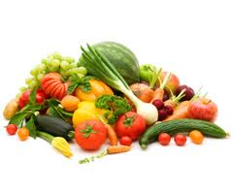
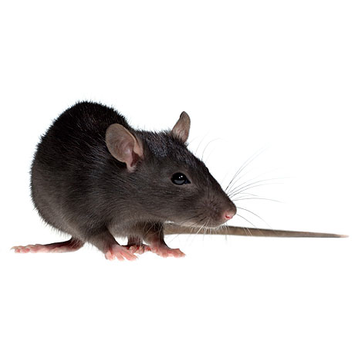
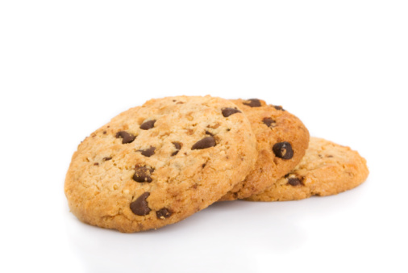
Tasty food
Normal food
nul
Choice probabilities
nul
eat tasty
food
eat normal
food
Internal state
Simulation specifications:
average over 2000 runs
algorithm: Q-learning + softmax
alpha = 0.25
beta = 50
gamma = 0.8
m = 2
n = 4
initial internal state = -50
optimal internal state = -5
food outcome = 4
energy expenditure per step = 1
Taste-Induced Reward = 0 or 100
Trial
A
B
nul
C
Tasty food
Normal food
nul
D
eat tasty
food
eat normal
food
Choice probabilities
Internal state
Trial
Figure 2
Trial

